Slide 1
Online fullstack web application for appointment booking
Júlia Jankó
Advisor: Gábor Kövesdán

Slide 2

Use case
List/Search providers
Manage profile
Book appointment
User
Manage appointments
Provider
Manage provided services

Slide 3



Architecture
React Frontend
Rest API
Spring Backend
JDBC
SQL server

Slide 4
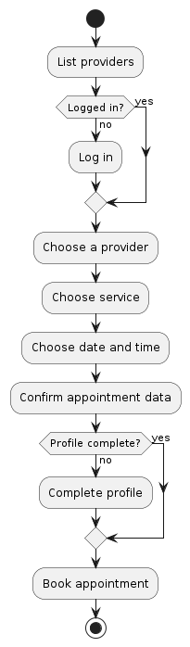
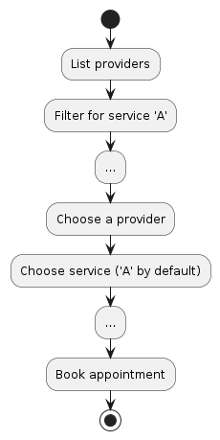
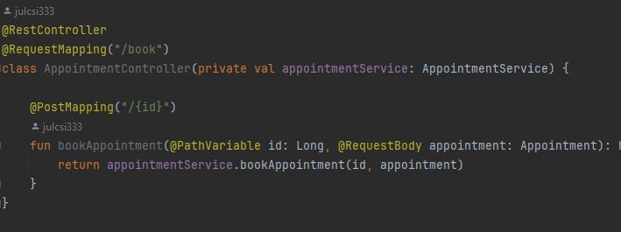
Appointment booking

Slide 5
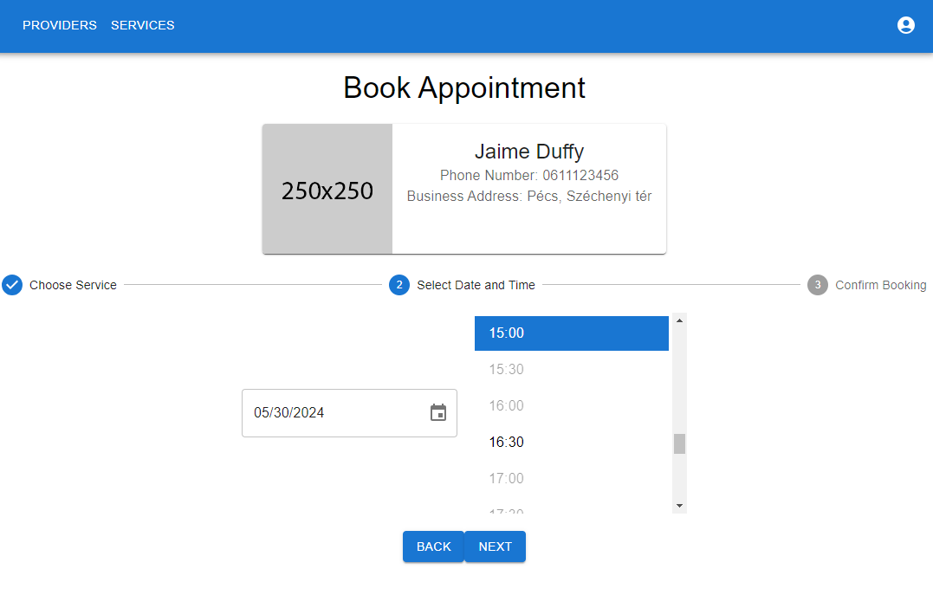
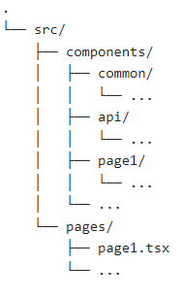
Initial frontend
TODO: Picture of frontend
Notes:
Tree source: https://tree.nathanfriend.io
MUI components!!!!

Slide 6
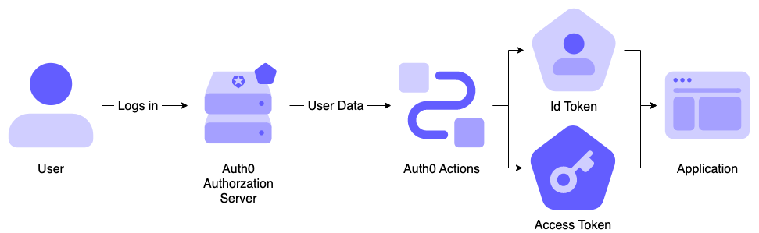
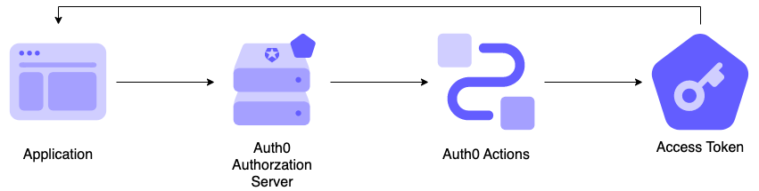
Authentication with Auth0
OpenID based authentication
Login flow
Machine to machine flow

Slide 7
Backend architecture
REST API
Business logic
Data access layer
Appointment controller
Appointment service
Appointment repository
User controller
User service
User repository
Provider controller
Provider service
Provider repository
Service controller
Service service
Service repository
Notes:
Fontos: függőségek végül egy fát alkossanak

Slide 8
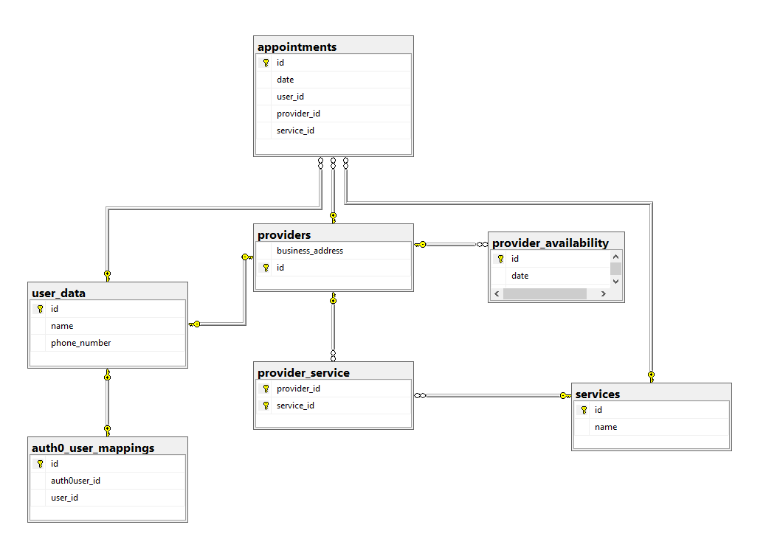
Data model
Notes:
Még nem teljes

Slide 9


Future work
E2E pipeline
Authentication flow
Some feature implementation
Complete required features
UI refinement
Extra features

